Slide 1
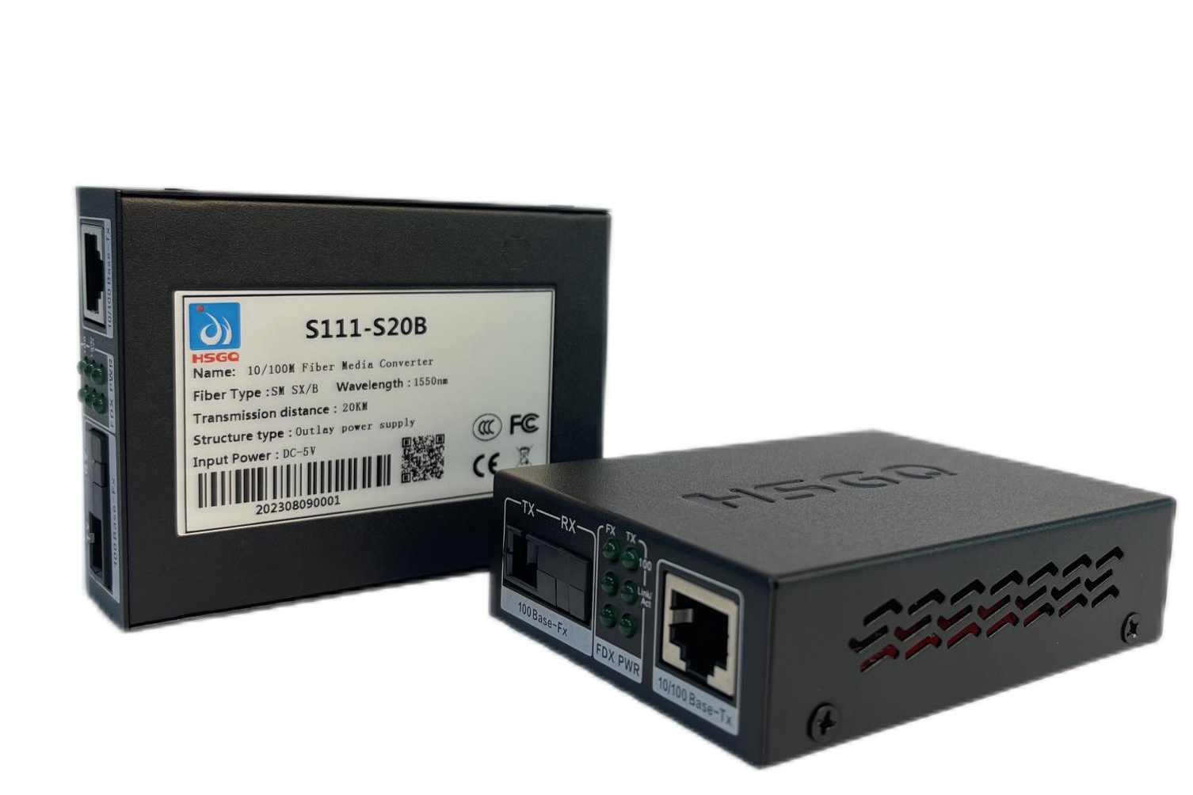
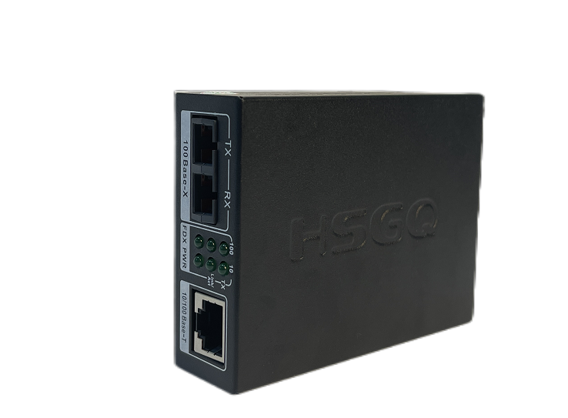
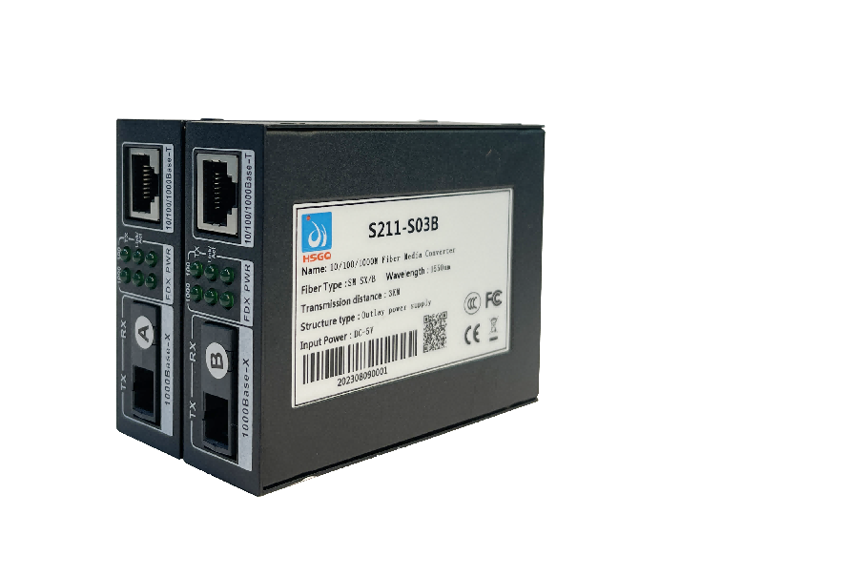
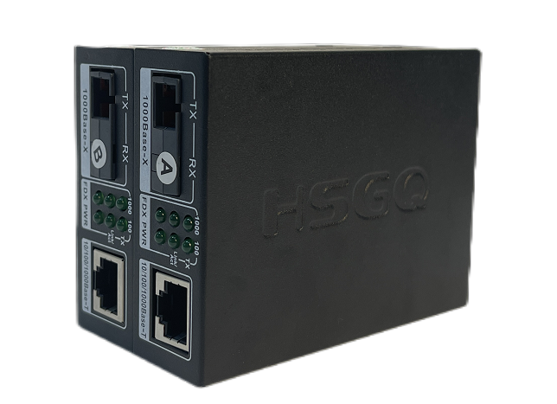
Fiber Media Converter Series Datasheet | S111-S20A/B, S111-S20, S211-S20, S211-S20A/B, S211-S03A/B
Fiber Media Converter
Product Overview
Fiber Media Converter Series is a 1000M fiber transceiver with one 100M or 1000Base-T (x) adaptive Ethernet RJ45 interface. It can help users realize the functions of Ethernet data exchange, aggregation and long-distance optical transmission. The equipment adopts fan free and low-power design, which has the advantages of convenient use, small volume and simple maintenance. The product design meets the Ethernet standard, and the performance is stable and reliable. The equipment can be widely used in various broadband data transmission fields such as intelligent transportation, telecommunications, security, finance and securities, customs, shipping, electric power, water conservancy and oil field.
Key Features
Supports three packet frame forwarding modes: store and forward mode, modifiedcut-through mode and pure converter" forwarding mode, limited delay reduction
Supports the Link Fault Pass Through function
Supports Far End Fault function
Supports 1600Byte long data packet transmission.
Supports the AUTO-MDI-MDIX function of network ports
Standard
IEEE 802.3
IEEE 802.3u
IEEE 802.3x

Slide 2

Technical Parameter
Model | S111-S20A/B | S111-S20 | S211-S20 | S211-S20A/B | S211-S03A/B
Ports | 1x10/100 Mbps+1G SC |  | 1x10/100/1000 Mbps+1G SC
Mode | Single mode Single fiber | Single mode Dual Fiber | Single mode Dual Fiber | Single mode Single fiber | Single mode Single fiber
Wavelength | TX 1310nm RX 1550nm
Transmission Distance | 20 km |  |  |  | 3 km
Power Supply | DC 5V
MAC Address table | 4K
Operating Temperature | -40°C~+75°C
MBTF | 10W h
Error Rate | <1/1000000000
Power Consumption | ＜4W
Relative Humidity | 5 ~ 95% (no frost)
Size | 94.5mm×71.5mm×25.8mm

Slide 3
Package Content
Welcome to order our products. After purchasing, you will receive:
Items | Quantity
S111-S20A/B or S111-S20 or S211-S20 or S211-S20A/B or S211-S03A/B | 1 Pair for S111-S20A/B, S211-S20A/B, S211-S03A/B 1 PC for S111-S20 , S211-S20
DV 5V | 2 PC for S111-S20A/B, S211-S20A/B, S211-S03A/B 1 PC for S111-S20 , S211-S20
Warranty Card | 1 PC
Ordering Information
Product Model | Descriptions
S111-S20A/B | 1*10/100M Ethernet interface(RJ45) 1*SC 1*Pair Single mode Single fiber 20km
S111-S20 | 1*10/100M Ethernet interface(RJ45) 1* SC Single mode Dual fiber 20km
S211-S20 | 1*10/100/1000M Ethernet interface(RJ45) 1*SC Single mode Dual fiber 20km
S211-S20A/B | 1*10/100/1000M Ethernet interface(RJ45) 1*SC Single mode Single fiber 20km
S211-S03A/B | 1*10/100/1000M Ethernet interface(RJ45) 1*SC Single mode Single fiber 3km

